Slide 1
CHAPTER 2
ARRAYS AND STRUCTURES
All the programs in this file are selected from
Ellis Horowitz, Sartaj Sahni, and Susan Anderson-Freed
“Fundamentals of Data Structures in C”,
Computer Science Press, 1992.
CHAPTER 2

Slide 2
Arrays
Array: a set of index and value
data structure
For each index, there is a value associated with
that index.
representation (possible)
implemented by using consecutive memory.
CHAPTER 2

Slide 3
Structure Array is objects: A set of pairs <index, value> where for each value of index there is a value from the set item. Index is a finite ordered set of one or more dimensions, for example, {0, … , n-1} for one dimension,
{(0,0),(0,1),(0,2),(1,0),(1,1),(1,2),(2,0),(2,1),(2,2)} for two dimensions, etc.
Functions: for all A ∈ Array, i ∈ index, x ∈ item, j, size ∈ integer
Array Create(j, list) ::= return an array of j dimensions where list is a j-tuple whose ith element is the size of the ith dimension. Items are undefined.
Item Retrieve(A, i) ::= if (i ∈ index) return the item associated with index value i in array A else return error
Array Store(A, i, x) ::= if (i in index) return an array that is identical to array
A except the new pair <i, x> has been inserted else return error end array
*Structure 2.1: Abstract Data Type Array ( p.50)
CHAPTER 2

Slide 4
Arrays in C
int list[5], *plist[5];
list[5]: five integers
list[0], list[1], list[2], list[3], list[4]
*plist[5]: five pointers to integers
plist[0], plist[1], plist[2], plist[3], plist[4]
implementation of 1-D array
list[0] base address = α
list[1] α + sizeof(int)
list[2] α + 2*sizeof(int)
list[3] α + 3*sizeof(int)
list[4] α + 4*size(int)
CHAPTER 2

Slide 5
CHAPTER 2

Slide 6
Arrays in C (Continued)
Compare int *list1 and int list2[5] in C.
Same: list1 and list2 are pointers.
Difference: list2 reserves five locations.
Notations:
list2 - a pointer to list2[0]
(list2 + i) - a pointer to list2[i] (&list2[i])
*(list2 + i) - list2[i]
CHAPTER 2

Slide 7
Example: 1-dimension array addressing
int one[] = {0, 1, 2, 3, 4};
Goal: print out address and value
void print1(int *ptr, int rows)
{
/* print out a one-dimensional array using a pointer */
int i;
printf(“Address Contents\n”);
for (i=0; i < rows; i++)
printf(“%8u%5d\n”, ptr+i, *(ptr+i));
printf(“\n”);
}
CHAPTER 2

Slide 8
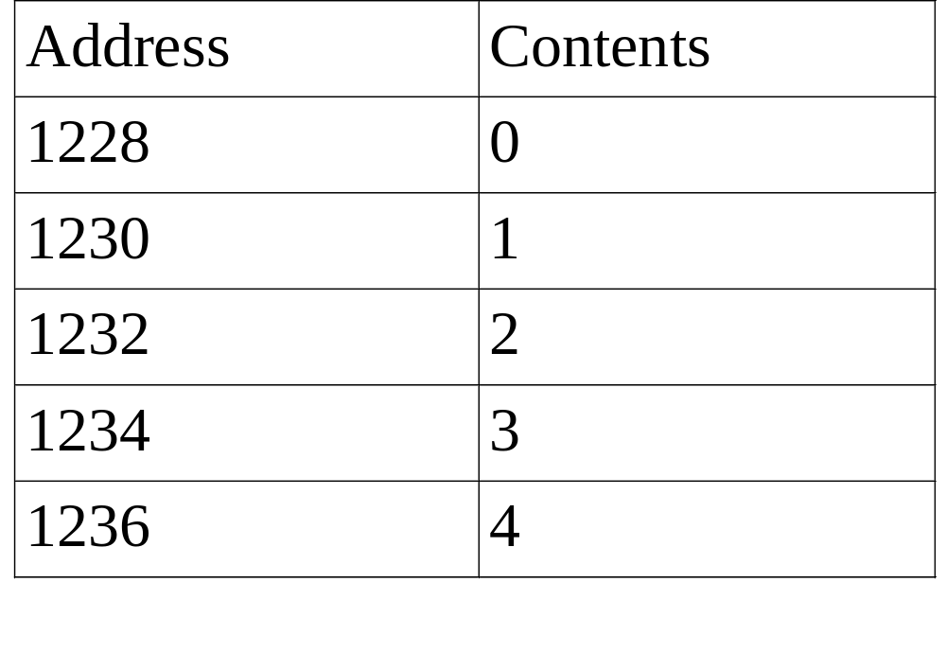
call print1(&one[0], 5)
*Figure 2.1: One- dimensional array addressing (p.53)
CHAPTER 2

Slide 9
Structures (records)
struct {
char name[10];
int age;
float salary;
} person;
strcpy(person.name, “james”);
person.age=10;
person.salary=35000;
CHAPTER 2

Slide 10
Create structure data type
typedef struct human_being {
char name[10];
int age;
float salary;
};
or
typedef struct {
char name[10];
int age;
float salary
} human_being;
human_being person1, person2;
CHAPTER 2

Slide 11
Unions
Similar to struct, but only one field is active.
Example: Add fields for male and female.
typedef struct sex_type {
enum tag_field {female, male} sex;
union {
int children;
int beard;
} u;
};
typedef struct human_being {
char name[10];
int age;
float salary;
date dob;
sex_type sex_info;
}
human_being person1, person2;
person1.sex_info.sex=male;
person1.sex_info.u.beard=FALSE;
CHAPTER 2

Slide 12
Self-Referential Structures
One or more of its components is a pointer to itself.
typedef struct list {
char data;
list *link;
}
list item1, item2, item3;
item1.data=‘a’;
item2.data=‘b’;
item3.data=‘c’;
item1.link=item2.link=item3.link=NULL;
Construct a list with three nodes
item1.link=&item2;
item2.link=&item3;
malloc: obtain a node
a
b
c
CHAPTER 2

Slide 13
Ordered List Examples
ordered (linear) list: (item1, item2, item3, …, itemn)
(MONDAY, TUEDSAY, WEDNESDAY, THURSDAY, FRIDAY, SATURDAYY, SUNDAY)
(2, 3, 4, 5, 6, 7, 8, 9, 10, Jack, Queen, King,
Ace)
(1941, 1942, 1943, 1944, 1945)
(a1, a2, a3, …, an-1, an)
CHAPTER 2

Slide 14
Operations on Ordered List
Find the length, n , of the list.
Read the items from left to right (or right to left).
Retrieve the i’th element.
Store a new value into the i’th position.
Insert a new element at the position i , causing elements numbered i, i+1, …, n to become numbered
i+1, i+2, …, n+1
Delete the element at position i , causing elements numbered i+1, …, n to become numbered i, i+1, …, n-1 array (sequential mapping)? (1)~(4) O (5)~(6) X
CHAPTER 2

Slide 15
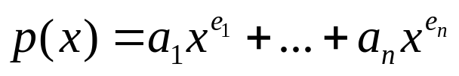
Structure Polynomial is objects: ; a set of ordered pairs of <e_{i},a_{i}> where a_{i} in Coefficients and e_{i} in Exponents, e_{i} are integers >= 0 functions: for all poly, poly1, poly2  Polynomial, coef Coefficients, expon  Exponents
Polynomial Zero( ) ::= return the polynomial, p(x) = 0
Boolean IsZero(poly) ::= if (poly) return FALSE else return TRUE
Coefficient Coef(poly, expon) ::= if (expon  poly) return its coefficient else return Zero
Exponent Lead_Exp(poly) ::= return the largest exponent in poly
Polynomial Attach(poly,coef, expon) ::= if (expon  poly) return error else return the polynomial poly with the term <coef, expon> inserted
Polynomials A(X)=3X²⁰+2X⁵+4, B(X)=X⁴+10X³+3X²+1
CHAPTER 2

Slide 16
Polynomial Remove(poly, expon) ::= if (expon  poly) return the polynomial poly with the term whose exponent is expon deleted else return error
Polynomial SingleMult(poly, coef, expon) ::= return the polynomial poly • coef • x^{expon}
Polynomial Add(poly1, poly2) ::= return the polynomial poly1 +poly2
Polynomial Mult(poly1, poly2) ::= return the polynomial poly1 • poly2
End Polynomial
*Structure 2.2:Abstract data type Polynomial (p.61)
CHAPTER 2

Slide 17
/* d =a + b, where a, b, and d are polynomials */ d = Zero( ) while (! IsZero(a) && ! IsZero(b)) do { switch COMPARE (Lead_Exp(a), Lead_Exp(b)) { case -1: d =
Attach(d, Coef (b, Lead_Exp(b)), Lead_Exp(b)); b = Remove(b, Lead_Exp(b)); break; case 0: sum = Coef (a, Lead_Exp (a)) + Coef ( b, Lead_Exp(b)); if (sum) {
Attach (d, sum, Lead_Exp(a)); a = Remove(a , Lead_Exp(a)); b = Remove(b , Lead_Exp(b));
} break;
Polynomial Addition
data structure 1:
#define MAX_DEGREE 101
typedef struct {
int degree;
float coef[MAX_DEGREE];
} polynomial;
CHAPTER 2

Slide 18
case 1: d =
Attach(d, Coef (a, Lead_Exp(a)), Lead_Exp(a)); a = Remove(a, Lead_Exp(a));
}
} insert any remaining terms of a or b into d
advantage: easy implementation
disadvantage: waste space when sparse
*Program 2.4 :Initial version of padd function(p.62)
CHAPTER 2

Slide 19
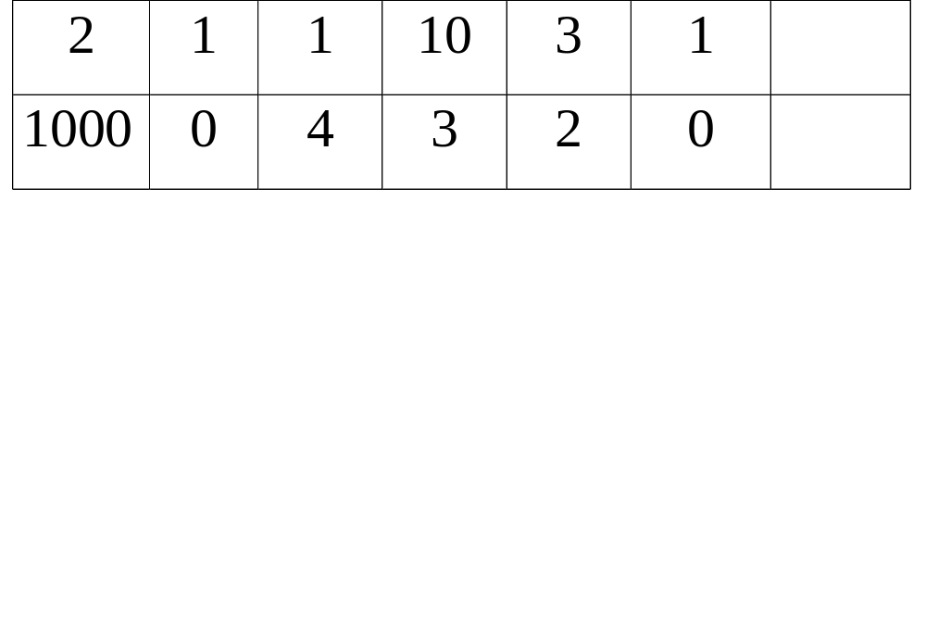
Data structure 2: use one global array to store all polynomials
A(X)=2X¹⁰⁰⁰+1X3+10
B(X)=X⁴+10X³+3X²+1
*Figure 2.2: Array representation of two polynomials
(p.63)
starta finisha startb finishb avail
coef
exp
0 1 2 3 4 5 6
specification representation
poly <start, finish>
A <0,1>
B <2,5>
CHAPTER 2

Slide 20
storage requirements: start, finish, 2*(finish-start+1)
nonparse: twice as much as (1)
when all the items are nonzero
MAX_TERMS 100 /* size of terms array */
typedef struct {
float coef;
int expon;
} polynomial;
polynomial terms[MAX_TERMS];
int avail = 0;
*(p.62)
CHAPTER 2

Slide 21
void padd (int starta, int finisha, int startb, int finishb, int * startd, int *finishd)
{
/* add A(x) and B(x) to obtain D(x) */ float coefficient;
*startd = avail; while (starta <= finisha && startb <= finishb) switch (COMPARE(terms[starta].expon, terms[startb].expon)) { case -1: /* a expon < b expon */ attach(terms[startb].coef, terms[startb].expon); startb++ break;
Add two polynomials: D = A + B
CHAPTER 2

Slide 22
case 0: /* equal exponents */ coefficient = terms[starta].coef + terms[startb].coef; if (coefficient) attach (coefficient, terms[starta].expon); starta++; startb++; break; case 1: /* a expon > b expon */ attach(terms[starta].coef, terms[starta].expon); starta++;
}
CHAPTER 2

Slide 23
/* add in remaining terms of A(x) */ for( ; starta <= finisha; starta++) attach(terms[starta].coef, terms[starta].expon);
/* add in remaining terms of B(x) */ for( ; startb <= finishb; startb++) attach(terms[startb].coef, terms[startb].expon);
*finishd =avail -1;
}
Analysis: O(n+m)
where n (m) is the number of nonzeros in A(B).
*Program 2.5: Function to add two polynomial (p.64)
CHAPTER 2

Slide 24
void attach(float coefficient, int exponent)
{
/* add a new term to the polynomial */ if (avail >= MAX_TERMS) { fprintf(stderr, “Too many terms in the polynomial\n”); exit(1);
} terms[avail].coef = coefficient; terms[avail++].expon = exponent;
}
*Program 2.6:Function to add anew term (p.65)
Problem: Compaction is required
when polynomials that are no longer needed.
(data movement takes time.)
CHAPTER 2

Slide 25
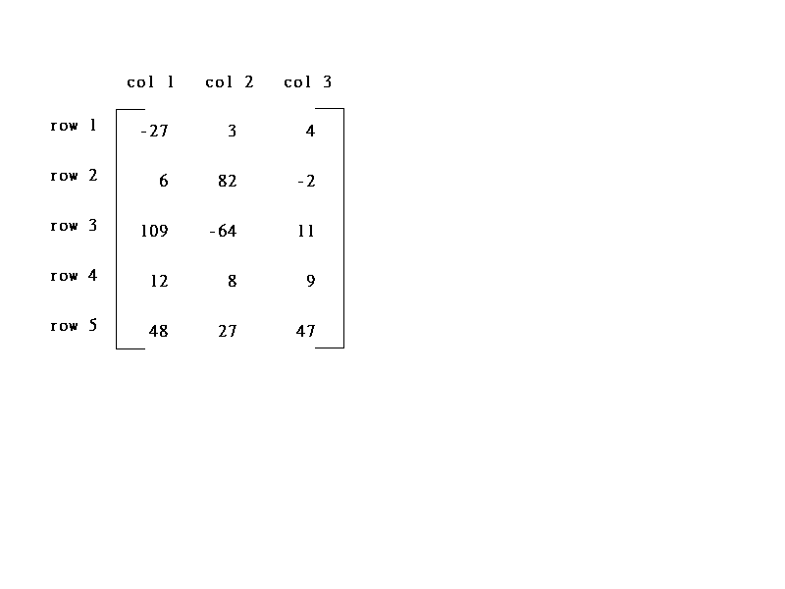
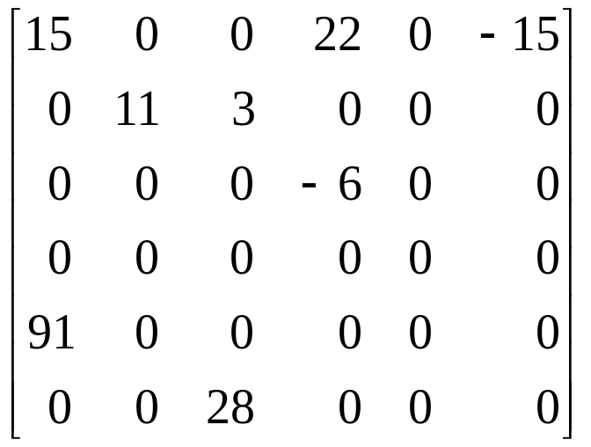
Sparse Matrix
col1 col2 col3 col4 col5 col6
row0
row1
row2
row3
row4
row5
5*3
6*6
(a) (b)
*Figure 2.3:Two matrices
15/15
8/36
sparse matrix
data structure?
CHAPTER 2

Slide 26
Structure Sparse_Matrix is objects: a set of triples, <row, column, value>, where row and column are integers and form a unique combination, and value comes from the set item. functions: for all a, b ∈ Sparse_Matrix, x  item, i, j, max_col, max_row  index
Sparse_Marix Create(max_row, max_col) ::= return a Sparse_matrix that can hold up to max_items = max _row  max_col and whose maximum row size is max_row and whose maximum column size is max_col.
SPARSE MATRIX ABSTRACT DATA TYPE
CHAPTER 2

Slide 27
Sparse_Matrix Transpose(a) ::= return the matrix produced by interchanging the row and column value of every triple.
Sparse_Matrix Add(a, b) ::= if the dimensions of a and b are the same return the matrix produced by adding corresponding items, namely those with identical row and column values. else return error
Sparse_Matrix Multiply(a, b) ::= if number of columns in a equals number of rows in b return the matrix d produced by multiplying a by b according to the formula: d [i] [j] =
(a[i][k]•b[k][j]) where d (i, j) is the (i,j)th element else return error.
CHAPTER 2
* Structure 2.3: Abstract data type Sparse-Matrix (p.68)

Slide 28
(1) Represented by a two-dimensional array.
Sparse matrix wastes space.
(2) Each element is characterized by <row, col, value>.
row col value row col value
a[0] 6 6 8 b[0] 6 6 8
[1] 0 0 15 [1] 0 0 15
[2] 0 3 22 [2] 0 4 91
[3] 0 5 -15 [3] 1 1 11
[4] 1 1 11 [4] 2 1 3
[5] 1 2 3 [5] 2 5 28
[6] 2 3 -6 [6] 3 0 22
[7] 4 0 91 [7] 3 2 -6
[8] 5 2 28 [8] 5 0 -15
# of rows (columns)
# of nonzero terms
transpose
(a) (b)
row, column in ascending order
*Figure 2.4:Sparse matrix and its transpose stored as triples (p.69)
CHAPTER 2

Slide 29
Sparse_matrix Create(max_row, max_col) ::=
#define MAX_TERMS 101 /* maximum number of terms +1*/ typedef struct { int col; int row; int value;
} term; term a[MAX_TERMS]
# of rows (columns)
# of nonzero terms
* (P.69)
CHAPTER 2

Slide 30
Transpose a Matrix
(1) for each row i
take element <i, j, value> and store it
in element <j, i, value> of the transpose.
difficulty: where to put <j, i, value>
(0, 0, 15) ====> (0, 0, 15)
(0, 3, 22) ====> (3, 0, 22)
(0, 5, -15) ====> (5, 0, -15)
(1, 1, 11) ====> (1, 1, 11)
Move elements down very often.
(2) For all elements in column j,
place element <i, j, value> in element <j, i, value>
CHAPTER 2

Slide 31
void transpose (term a[], term b[])
/* b is set to the transpose of a */
{ int n, i, j, currentb; n = a[0].value; /* total number of elements */ b[0].row = a[0].col; /* rows in b = columns in a */ b[0].col = a[0].row; /*columns in b = rows in a */ b[0].value = n; if (n > 0) { /*non zero matrix */ currentb = 1; for (i = 0; i < a[0].col; i++)
/* transpose by columns in a */ for( j = 1; j <= n; j++)
/* find elements from the current column */ if (a[j].col == i) {
/* element is in current column, add it to b */
CHAPTER 2

Slide 32
b[currentb].row = a[j].col; b[currentb].col = a[j].row; b[currentb].value = a[j].value; currentb++
}
}
}
columns
elements
* Program 2.7: Transpose of a sparse matrix (p.71)
Scan the array “columns” times.
The array has “elements” elements.
==> O(columns*elements)
CHAPTER 2

Slide 33
Discussion: compared with 2-D array representation
O(columns*elements) vs. O(columns*rows)
elements --> columns * rows when nonsparse
O(columns*columns*rows)
Problem: Scan the array “columns” times.
Solution:
Determine the number of elements in each column of
the original matrix.
==>
Determine the starting positions of each row in the
transpose matrix.
CHAPTER 2

Slide 34
[0] [1] [2] [3] [4] [5] row_terms = 2 1 2 2 0 1 starting_pos = 1 3 4 6 8 8
a[0] 6 6 8
a[1] 0 0 15
a[2] 0 3 22
a[3] 0 5 -15
a[4] 1 1 11
a[5] 1 2 3
a[6] 2 3 -6
a[7] 4 0 91
a[8] 5 2 28
CHAPTER 2

Slide 35
a[0] 6 6 8
a[1] 0 0 15
a[2] 0 3 22
a[3] 0 5 -15
a[4] 1 1 11
a[5] 1 2 3
a[6] 2 3 -6
a[7] 4 0 91
a[8] 5 2 28
CHAPTER 2

Slide 36
void fast_transpose(term a[ ], term b[ ])
{
/* the transpose of a is placed in b */ int row_terms[MAX_COL], starting_pos[MAX_COL]; int i, j, num_cols = a[0].col, num_terms = a[0].value; b[0].row = num_cols; b[0].col = a[0].row; b[0].value = num_terms; if (num_terms > 0){ /*nonzero matrix*/ for (i = 0; i < num_cols; i++) row_terms[i] = 0; for (i = 1; i <= num_terms; i++) row_term [a[i].col]++ starting_pos[0] = 1; for (i =1; i < num_cols; i++) starting_pos[i]=starting_pos[i-1] +row_terms [i-1];
columns
elements
columns
CHAPTER 2

Slide 37
for (i=1; i <= num_terms, i++) { j = starting_pos[a[i].col]++; b[j].row = a[i].col; b[j].col = a[i].row; b[j].value = a[i].value;
}
}
}
*Program 2.8:Fast transpose of a sparse matrix
elements
Compared with 2-D array representation
O(columns+elements) vs. O(columns*rows)
elements --> columns * rows
O(columns+elements) --> O(columns*rows)
Cost: Additional row_terms and starting_pos arrays are required.
Let the two arrays row_terms and starting_pos be shared.
CHAPTER 2

Slide 38
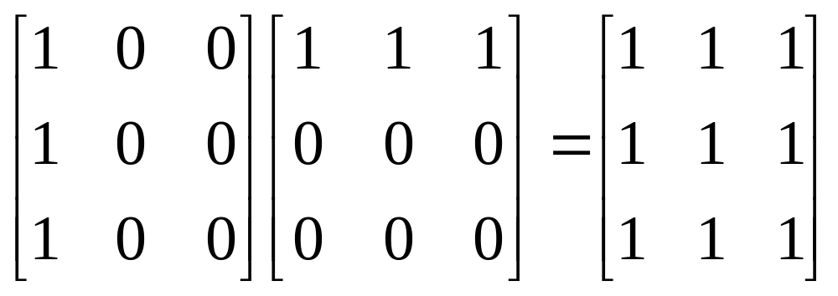
Sparse Matrix Multiplication
Definition: [D]_{m*p}=[A]_{m*n}* [B]_{n*p}
Procedure: Fix a row of A and find all elements in column j
of B for j=0, 1, …, p-1.
Alternative 1. Scan all of B to find all elements in j.
Alternative 2. Compute the transpose of B.
(Put all column elements consecutively)
CHAPTER 2
*Figure 2.5:Multiplication of two sparse matrices (p.73)

Slide 39
A = 1 0 2 B = 3 0 2
-1 4 6 -1 0 0
0 0 5
2 3 5 3 3 4
0 0 1 0 0 3
0 2 2 0 2 2
1 0 -1 1 0 -1
1 1 4 2 2 5
1 2 6
B^{T} = 3 -1 0 3 3 4
0 0 0 0 0 3
2 0 5 0 1 -1
2 0 2
2 2 5
An Example
(0,0)
(0,2)
(1,0)
(1,2)
CHAPTER 2

Slide 40
General Case
d_{ij}=a_{i0}*b_{0j}+a_{i1}*b_{1j}+…+a_{i(n-1)*}b_{(n-1)j}
a本來依i成群，經轉置後，b也依j成群。
a Sa d Sd
b Sb e Se
c Sc f Sf
g Sg
最多可以產生ad, ae, af, ag,
bd, be, bf, bg,
cd, ce, cf, cg 等entries 。
CHAPTER 2

Slide 41
void mmult (term a[ ], term b[ ], term d[ ] )
/* multiply two sparse matrices */
{ int i, j, column, totalb = b[].value, totald = 0; int rows_a = a[0].row, cols_a = a[0].col, totala = a[0].value; int cols_b = b[0].col, int row_begin = 1, row = a[1].row, sum =0; int new_b[MAX_TERMS][3]; if (cols_a != b[0].row){ fprintf (stderr, “Incompatible matrices\n”); exit (1);
}
CHAPTER 2

Slide 42
fast_transpose(b, new_b);
/* set boundary condition */ a[totala+1].row = rows_a; new_b[totalb+1].row = cols_b; new_b[totalb+1].col = 0; for (i = 1; i <= totala; ) { column = new_b[1].row; for (j = 1; j <= totalb+1;) {
/* mutiply row of a by column of b */ if (a[i].row != row) { storesum(d, &totald, row, column, &sum); i = row_begin; for (; new_b[j].row == column; j++)
; column =new_b[j].row
}
cols_b + totalb
at most rows_a times
CHAPTER 2

Slide 43
else switch (COMPARE (a[i].col, new_b[j].col)) { case -1: /* go to next term in a */ i++; break; case 0: /* add terms, go to next term in a and b */ sum += (a[i++].value * new_b[j++].value); break; case 1: /* advance to next term in b*/ j++
}
} /* end of for j <= totalb+1 */ for (; a[i].row == row; i++)
; row_begin = i; row = a[i].row;
} /* end of for i <=totala */ d[0].row = rows_a; d[0].col = cols_b; d[0].value = totald;
}
*Praogram 2.9: Sparse matrix multiplication (p.75)
CHAPTER 2

Slide 44
Analyzing the algorithm
cols_b * termsrow₁ + totalb +
cols_b * termsrow₂ + totalb +
… +
cols_b * termsrow_{p} + totalb
= cols_b * (termsrow₁ + termsrow₂ + … + termsrow_{p}) +
rows_a * totalb
= cols_b * totala + row_a * totalb
O(cols_b * totala + rows_a * totalb)
CHAPTER 2

Slide 45
for (i =0; i < rows_a; i++) for (j=0; j < cols_b; j++) { sum =0; for (k=0; k < cols_a; k++) sum += (a[i][k] *b[k][j]); d[i][j] =sum;
}
Compared with matrix multiplication using array
O(rows_a * cols_a * cols_b) vs.
O(cols_b * total_a + rows_a * total_b)
optimal case: total_a < rows_a * cols_a
total_b < cols_a * cols_b
worse case: total_a --> rows_a * cols_a, or
total_b --> cols_a * cols_b
CHAPTER 2

Slide 46
void storesum(term d[ ], int *totald, int row, int column, int *sum)
{
/* if *sum != 0, then it along with its row and column position is stored as the *totald+1 entry in d */ if (*sum) if (*totald < MAX_TERMS) { d[++*totald].row = row; d[*totald].col = column; d[*totald].value = *sum;
} else { fprintf(stderr, ”Numbers of terms in product exceed %d\n”, MAX_TERMS); exit(1);
}
}
CHAPTER 2
Program 2.10: storsum function

